Slide 1


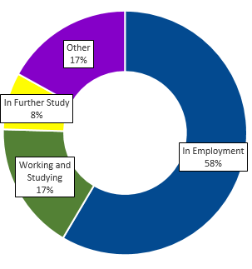

BSc Criminology/Criminology with Forensic Psychology
My Student Journey experiential map
Get started
Get experience
Get Graduate Ready
Meet new people and build your skills by joining a society like Criminology society or Pro Bono, Volunteering or finding a part-time job​​.
Apply for an insight programme with a graduate employer.
Utilise the insight day offered where you could attend locations such as the Crown Court.
Complete Core Module CR1002 ‘Criminal Justice in action’ and discover your unique strengths and skills.
Seek out opportunities to gain significant, CV-enhancing experience alongside your studies.
Think about relevant voluntary experience in areas that interest you.
Summer internships that develop teamwork, leadership and communication skills are also helpful.
Consider the benefits of an optional year or semester studying abroad before final year.
Complete Core Module CR2008 ‘Punishment and Rehabilitation’ to develop your expertise and apply your skills to enhance your employability.
Choose a module which provides you with an opportunity to gain real world experience and utilise the integrated modules developing your knowledge.
Speak with your project supervisor or the School Careers Tutor about other activities and support.
Attend a Criminology focused Careers event that provides the opportunity to speak with employers.
Complete module CR3008 ‘Student Project’ and apply to an area of your interest or project of your choice.
·
What career options can I pursue?
Checklist
Register to access pathways and support: le.ac.uk/my- student-journey
Civil Service, Local and Central Government roles
Police Force, Prison and Probation Services
Legal roles (Paralegal)
Community Development
Social Research
Counselling
Attend the Festival of Careers industry insights and more
And more besides: employers accept applications from graduates with any degree subject – including Criminology,
so don't restrict your thinking to the jobs listed here
Book an appoitment with a career coach to discuss your options
Skills provided by course
Skills required by employers
Generate and evaluate evidence
Make reasoned arguments and ethical judgements
Develop and present a cohesive argument
Research and solve problems or conflict that may arise when working
Gain an understanding of the agencies involved within the criminal justice system
Collect, analyse and interpret data
Write clear and concise reports
Work effectively in a team
Communicate clearly and effectively
Work in a team
Solve problems and make decisions
Lead and influence others
excellent interpersonal skills and the ability to relate to others
An understanding of working with challenging individuals who may have social or personal difficulties
Get your CV checked and participate in a mock interview
Drop in to the Career Hub (Location: Percy Gee 2nd floor) to ask questions and get help with your next step
Seek out and secure a significant Career experience
Find out more and get support. Visit the Career Development Service website or email Criminology Career Tutor on jd465@le.ac.uk

